Slide 1
CLASSIFICATION PROJECT ON WATER QUALITY PREDICTION
Prepared by Farooq Shaikh
Under The Guidance of
Rithik Raj
Imarticus Learning, Thane

Slide 2
Introduction :
Water is a critical resource for human survival and well-being, and its quality plays a crucial role in public health.
Access to clean and safe drinking water is essential for human health and well-being.
Contaminated or unsafe drinking water can lead to various waterborne diseases and health issues.
Ensuring the potability of water sources is a critical concern for public health authorities and environmental agencies.
In this classification project, we aim to use machine learning to predict and classify whether water is potable or non-potable based on its quality parameters.

Slide 3
Dataset :
The dataset provides information about various water quality parameters and whether the water is potable, meaning it is safe for human consumption.
The dataset includes various attributes that describe the composition and characteristics of water, such as pH, hardness, solids concentration, chloramines, sulfate, conductivity, organic carbon, trihalomethanes, and turbidity.
The dataset also provides a binary target variable, "Potability," which indicates whether the water is safe for consumption (potable) or not.

Slide 4
Objective :
The primary objective of this classification project is to build a machine learning model that can accurately classify water as either potable or non-potable based on its quality attributes.
By doing so, we aim to assist in assessing the safety of water sources and ensuring access to clean and safe drinking water.
Ensuring the potability of water is crucial for safeguarding public health.
By analyzing water quality parameters, the project can contribute to environmental monitoring and can help identify factors that may affect water quality.

Slide 5
Data Exploration
Data exploration is an important step in any machine learning project, including Linear regression(LR), Logistic regression(LoR), Support vector machine(SVM), Naive Bayes Classification(NB) and K-nearest neighbor(KNN).
It helps you understand your dataset, identify patterns, and prepare the data for modeling.
It also helps you to identify any potential issues, and select appropriate preprocessing and modeling strategies.
Data exploration steps includes importing the libraries, loading the dataset and initial data examination.

Slide 6
Data Preprocessing
Data preprocessing is also a crucial step in preparing any classification model.
Data preprocessing involves cleaning, transforming, and encoding the data so that it can be used effectively for training and testing the model.
This step includes :
Handling missing values: Depending on the dataset, imputing missing values using mean, median, or other methods.
Normalize or scale features, to ensure that all features have a similar scale.
Converting categorical variables into numerical representations.

Slide 7
Exploratory Data Analysis (EDA) :
Exploratory Data Analysis (EDA) helps to understand the relationships between variables, such as how features vary with the target variable.
So we have performed Exploratory Data Analysis (EDA) to gain insights into the dataset and understand the relationships between water quality attributes and potability.
Created visualizations like pair plots, bar plot, histogram, box plot, scatter plot, violin plot, strip plot, rel plot, kde plot, ecdf plot, rug plot, heatmaps, and correlation matrices to explore feature interactions.

Slide 8
Model Building
We have created several model using libraries like scikit-learn such as
Linear Regression
Logistic Regression
Support Vector Machines (SVM)
Naive Bayes
k-Nearest Neighbors (KNN)

Slide 9
Model Evaluation
In this project, we have assessed the performance of our model by using appropriate classification metrics such as accuracy, precision, recall, F1-score, classification report, confusion matrix. and ROC curve analysis.
Accuracy is the proportion of correct predictions over total predictions.
Precision measures how good our model is when the prediction is positive.
Recall measures how good our model is at correctly predicting positive classes.
F1 score is a machine learning evaluation metric that measures a model's accuracy. It combines the precision and recall scores of a model.
The ROC AUC score tells us how efficient the model is.
A classification report provides a summary of various metrics that describe the model's performance, such as precision, recall, and F1-score.
A confusion matrix is a table that is used to define the performance of a classification algorithm.

Slide 10
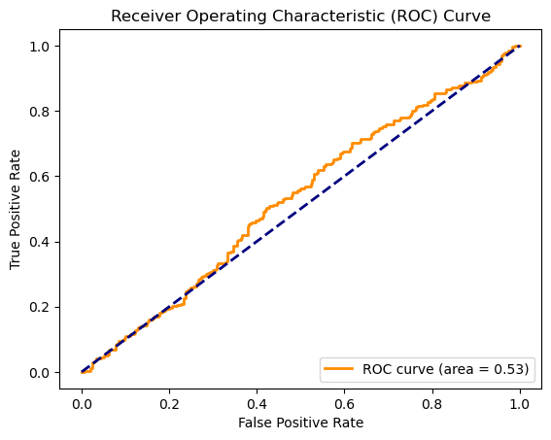
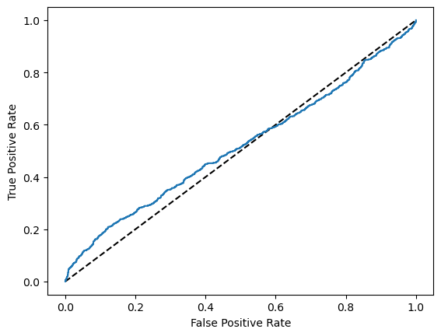
ROC Curve of Logictic Regression
ROC Curve of SVM

Slide 11
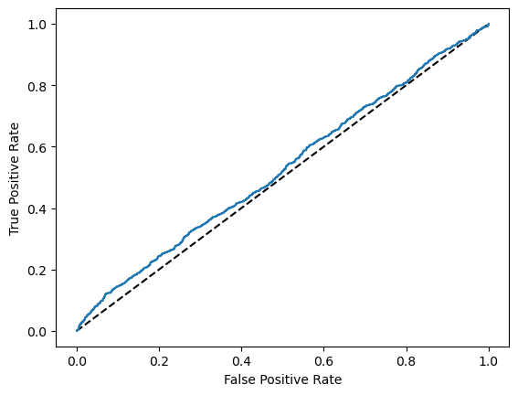
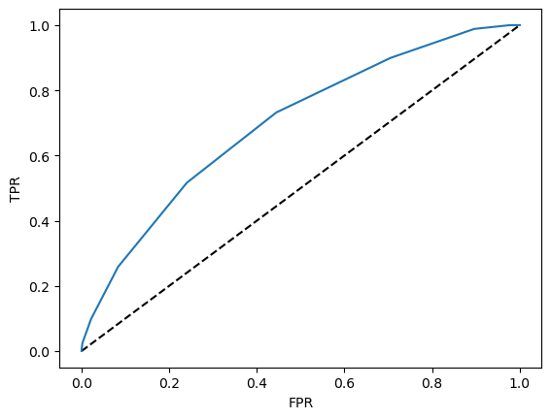
ROC Curve of Naive Bayes
ROC Curve of KNN

Slide 12
Accuracy Table
Model | Accuracy
Linear Regression | 1.8648%
Logistic Regression | 62.8049%
Support Vector Machine | 69.6646%
Naive Bayes | 62.8049%
K-Nearest Neighbor | 58.2317%

Slide 13
Conclusion
After performing different types of algorithm on the dataset we could see that each algorithm's model perform differently in order to classify the data and providing accuracy of doing the same.
From the accuracy table we can clearly conclude that the linear regression model is not performing well on the dataset giving us accuracy of 1.8 % only which shows how poorly it gives the relation between dependent and independent variables.
In classification models however the accuracies of all the models i.e. logistic, SVM, naive bayes, knn are in the range of 60% to 70% showing that their ability to classify the data is not really well, but if we want to choose one model out of these we would go for SVM as its accuracy is highest.

Slide 14
References
https://www.kaggle.com/datasets/adityakadiwal/water-potability
https://www.sciencedirect.com/science/article/pii/S1319157821001361
https://www.kaggle.com/code/priyanshu1235/water-quality-eda

Slide 15
Thank You

